Slide 1
COMMUNITY BOARD
By, Muhammad Aslam

Slide 2
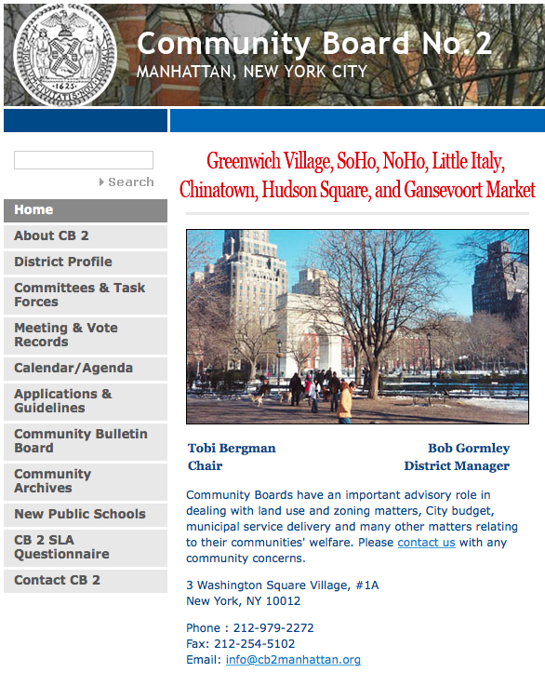
Map of Community Board 2 Manhattan
Community Board 2 Manhattan Website

Slide 3
Noise
Major Hot Spots:
West Street
Soho
Washington Square Park
Why?
Most of the complaints were made nearby the West Street, where are a lot of restaurants and bars, also its included in Soho area as well, which is known very well for shopping stores (Street Mall). Due to high population in these areas, a lot of complaints were made about too much noise.

Slide 4
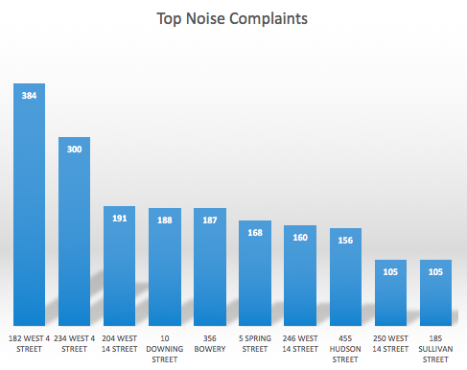

Slide 5
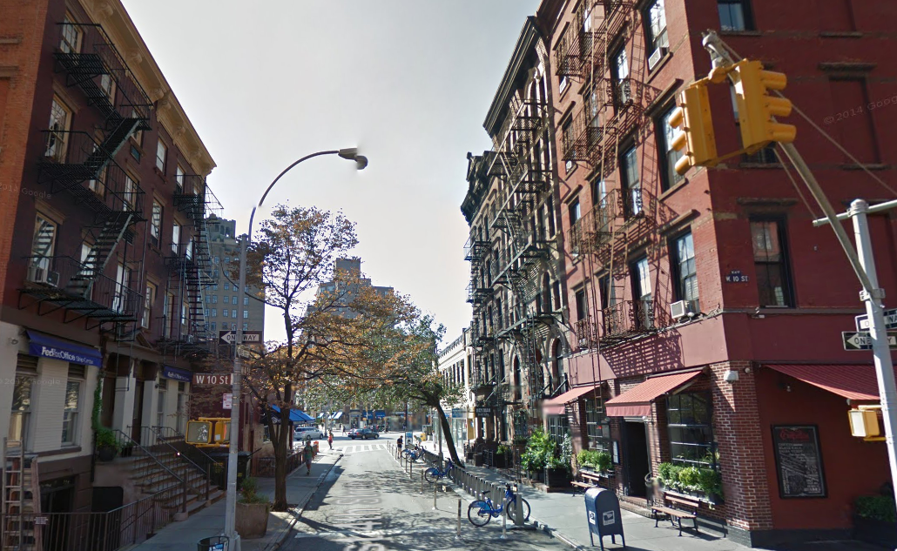
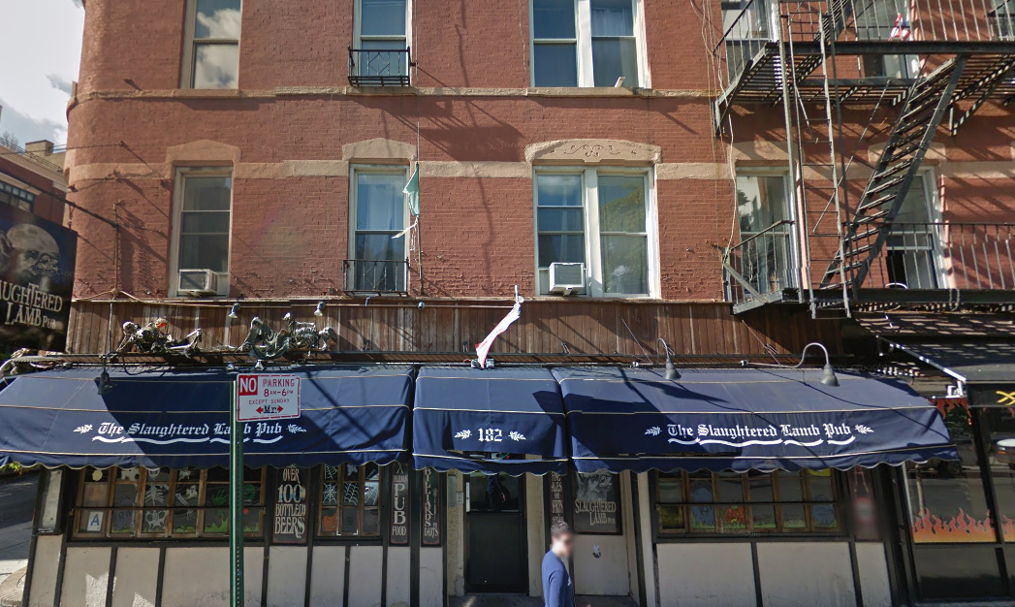
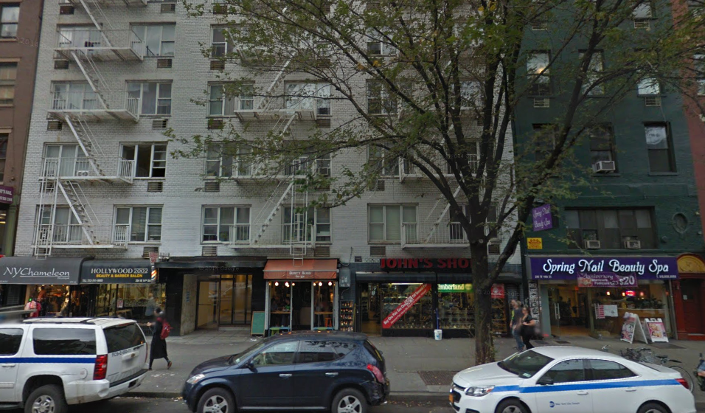
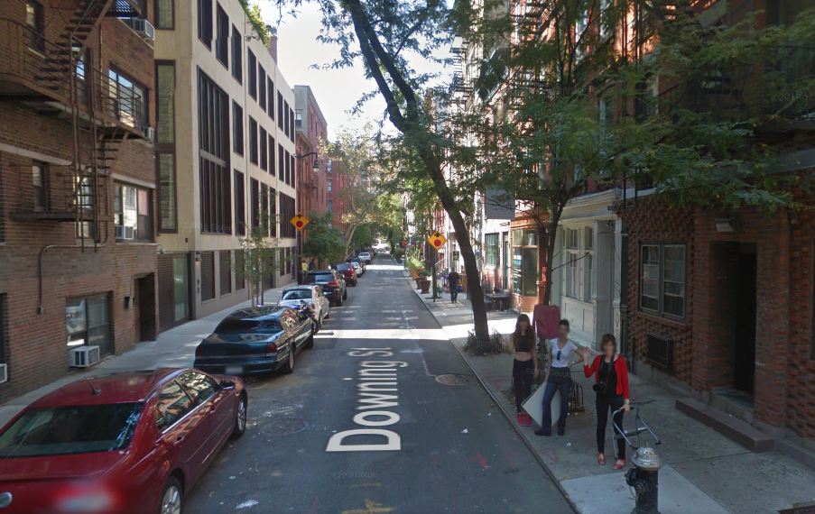
234 West 4 Street
182 West 4 Street
204 West 14 Street
10 Downing Street

Slide 6
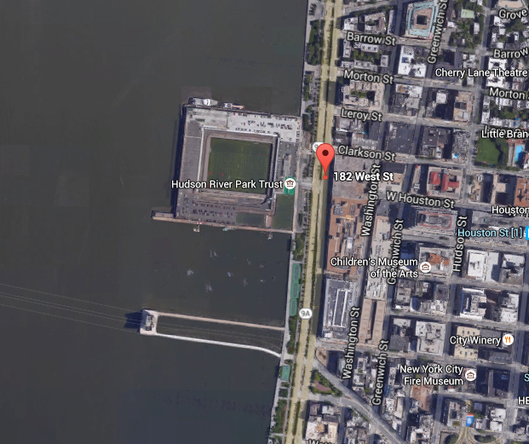
Why 182 West Street?
Assumptions:
West Street is Community Board 2 Manhattan, which is near the Hudson River, noise can be very common due to water, Hudson River Park Trust, Football Field and the big streets.

Slide 7
182 West 4 Street
The noise complaint for this specific location was the highest as compared to the other locations. 384 complaints were made from this location.
Facts About 182 West 4 Street
20 units
5 stories
Built in 1910

Slide 8
What makes 182 West 4 Street Location Different From others?
On the ground floor of 182 West 4 Street building there’s The Slaughtered Lamb Pub, where many people would go to hangout, due to many people being out theirs residents living they are complaining about too much noise.
Hours of The Slaughtered Lamb Pub
Thursday 12:00 PM – 1:00 AM
Friday 12:00 PM – 4:00 AM
Saturday 12:00 PM – 4:00 AM
Sunday 12:00 PM – 1:00 AM
Monday 12:00 PM – 1:00 AM
Tuesday 12:00 PM – 1:00 AM
Wednesday 12:00 PM – 1:00 AM
According to the late hours of The Slaughtered Lamb Pub, especially on Friday and Saturday nights it shows that overnight many people around might not be able to sleep due to noise.

Slide 9
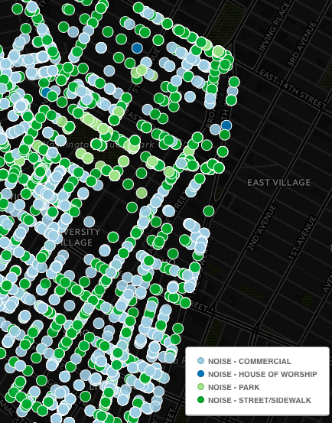
Locations Where The Noise Complaints Were Received
Click Here For The Full Map:
https://muhammad-aslam.cartodb.com/viz/3e30c81c-8a45-11e5-9e7a-0e5db1731f59/map

